Slide 1
Microsoft Power Automate Empowerment
Notes:
Hi, Welcome to Microsoft Power Platform + Dynamics 365 Bootcamp.

Slide 2
Course Overview
Day 1
Empowering everyone with Power Platform
Day 2
Power Automate Introduction
Day 3
Power Automate Project Scenarios
Day 4
Monitoring & Administration of Power Automate
Introduction to Power Platform
Microsoft Power Platform momentum
Why Power Platform?
Customer Stories
Power Platform Components Demo
Power Platform Account Setup
Microsoft Flow Basics
Microsoft Flow Templates
Decision Making with Flow
Conditions, Switches, Scope & Context of Decision-Making Control Elements
Building Workflows with Power Automate
Hands on Lab - Microsoft Flow
Approve / Reject Workflow Scenario
Recurrence Workflow Scenario
Errorless workflows Scenario
Build and Implement Custom Connector
Azure Cognitive Services AI Integration Workflow Scenario
Power App Integration Workflow Scenario
SQL Server Integration Workflow Scenario
HoL - End to End Business Flow with all Scenarios
UI Flows
Import, Export Flows
Distribute Flows
Sharing of Flows across workspaces
Different Flow Environments and Code Promotion
Data Policies & Integration Check Points
Flow History and Analytics
HoL - Check your Knowledge

Slide 3
Day4: Monitoring & Administration of Power Automate

Slide 4

Agenda
UI Flows
Import, Export Flows
Distribute Flows
Sharing of Flows across workspaces
Different Flow Environments and Code Promotion
Data Policies & Integration Check Points
Flow History and Analytics
HoL - Check your Knowledge

Slide 5

Demo

Slide 6
Securing your tenant

Slide 7
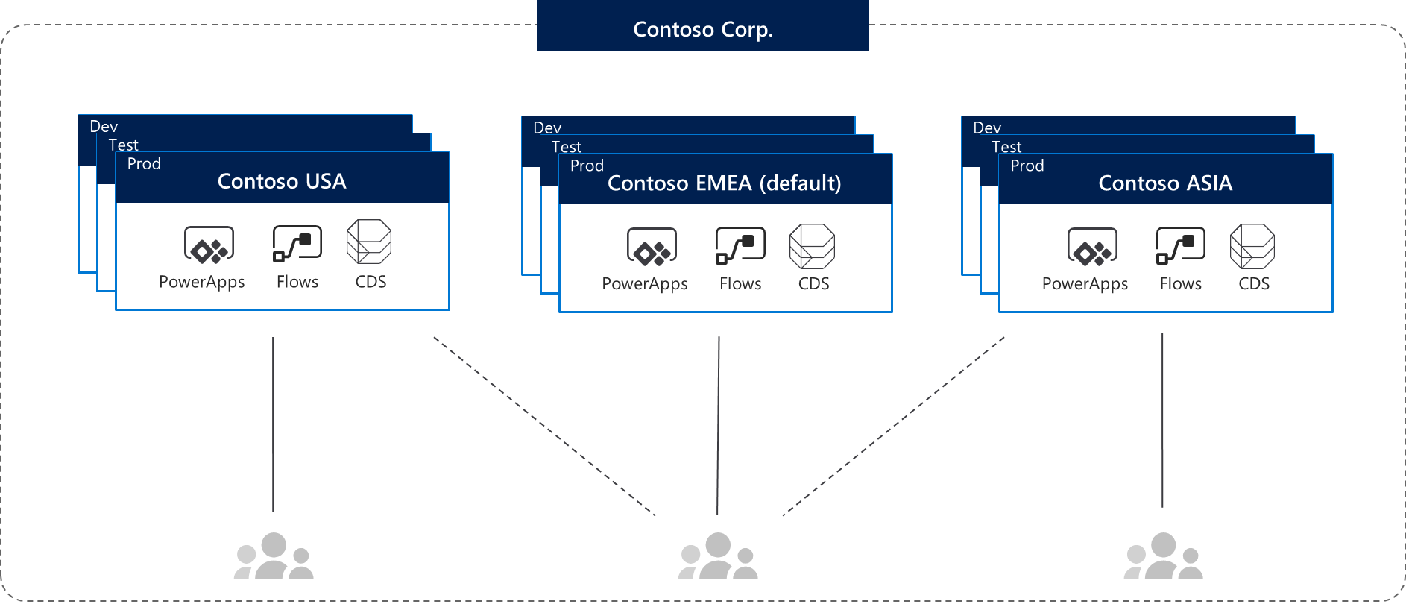
Environments
Environments are containers that administrators can use to manage apps, flows, connections, and other assets; along with permissions to allow organization users to use the resources

Slide 8
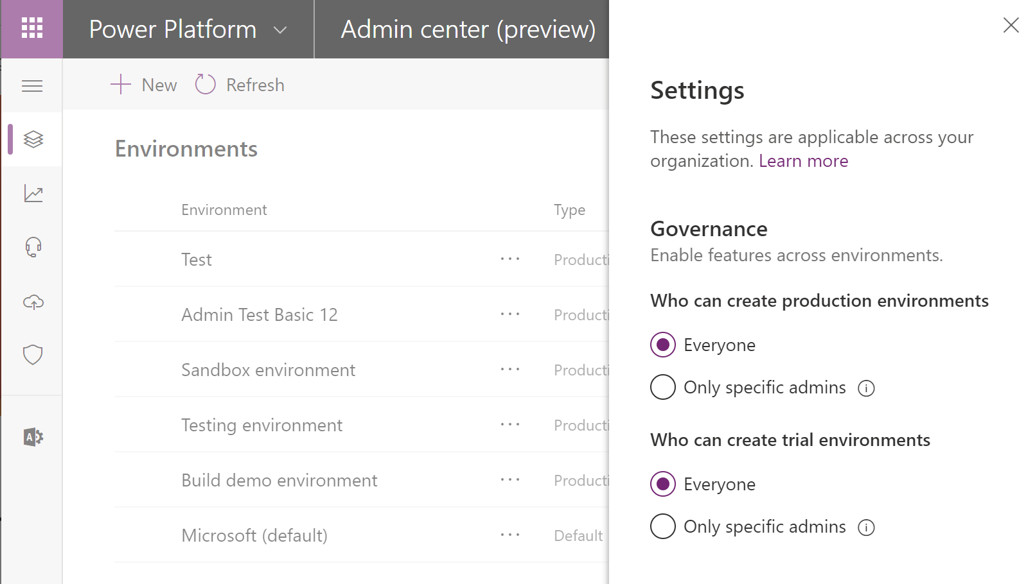
Environment key facts
Environments are tied to a geographic location that is configured at the time the environment is created
Environments can be used to target different audiences and/or for different purposes such as dev, test and production
Every tenant has a Default environment where all licensed PowerApps and Flow users can create apps & flows
Non-default environments offer more control around permissions
Non-default environment creation can be restricted to only global and service admins from the Power Platform admin center: https://aka.ms/ppac

Slide 9
Establish an environment strategy
Assign your admins the Power Platform service admin role, which grants full access to PowerApps, Flow, & PowerBI
Restrict the creation of net-new trial and production environments to admins
Treat the default environment as a ‘Personal productivity’ environment for your business groups (renaming the environment is recommended)
Establish a process for requesting access or creation of environments
Dev/Test/Production environments for specific business groups or applications
Individual-use environments for POCs and trainings

Slide 10
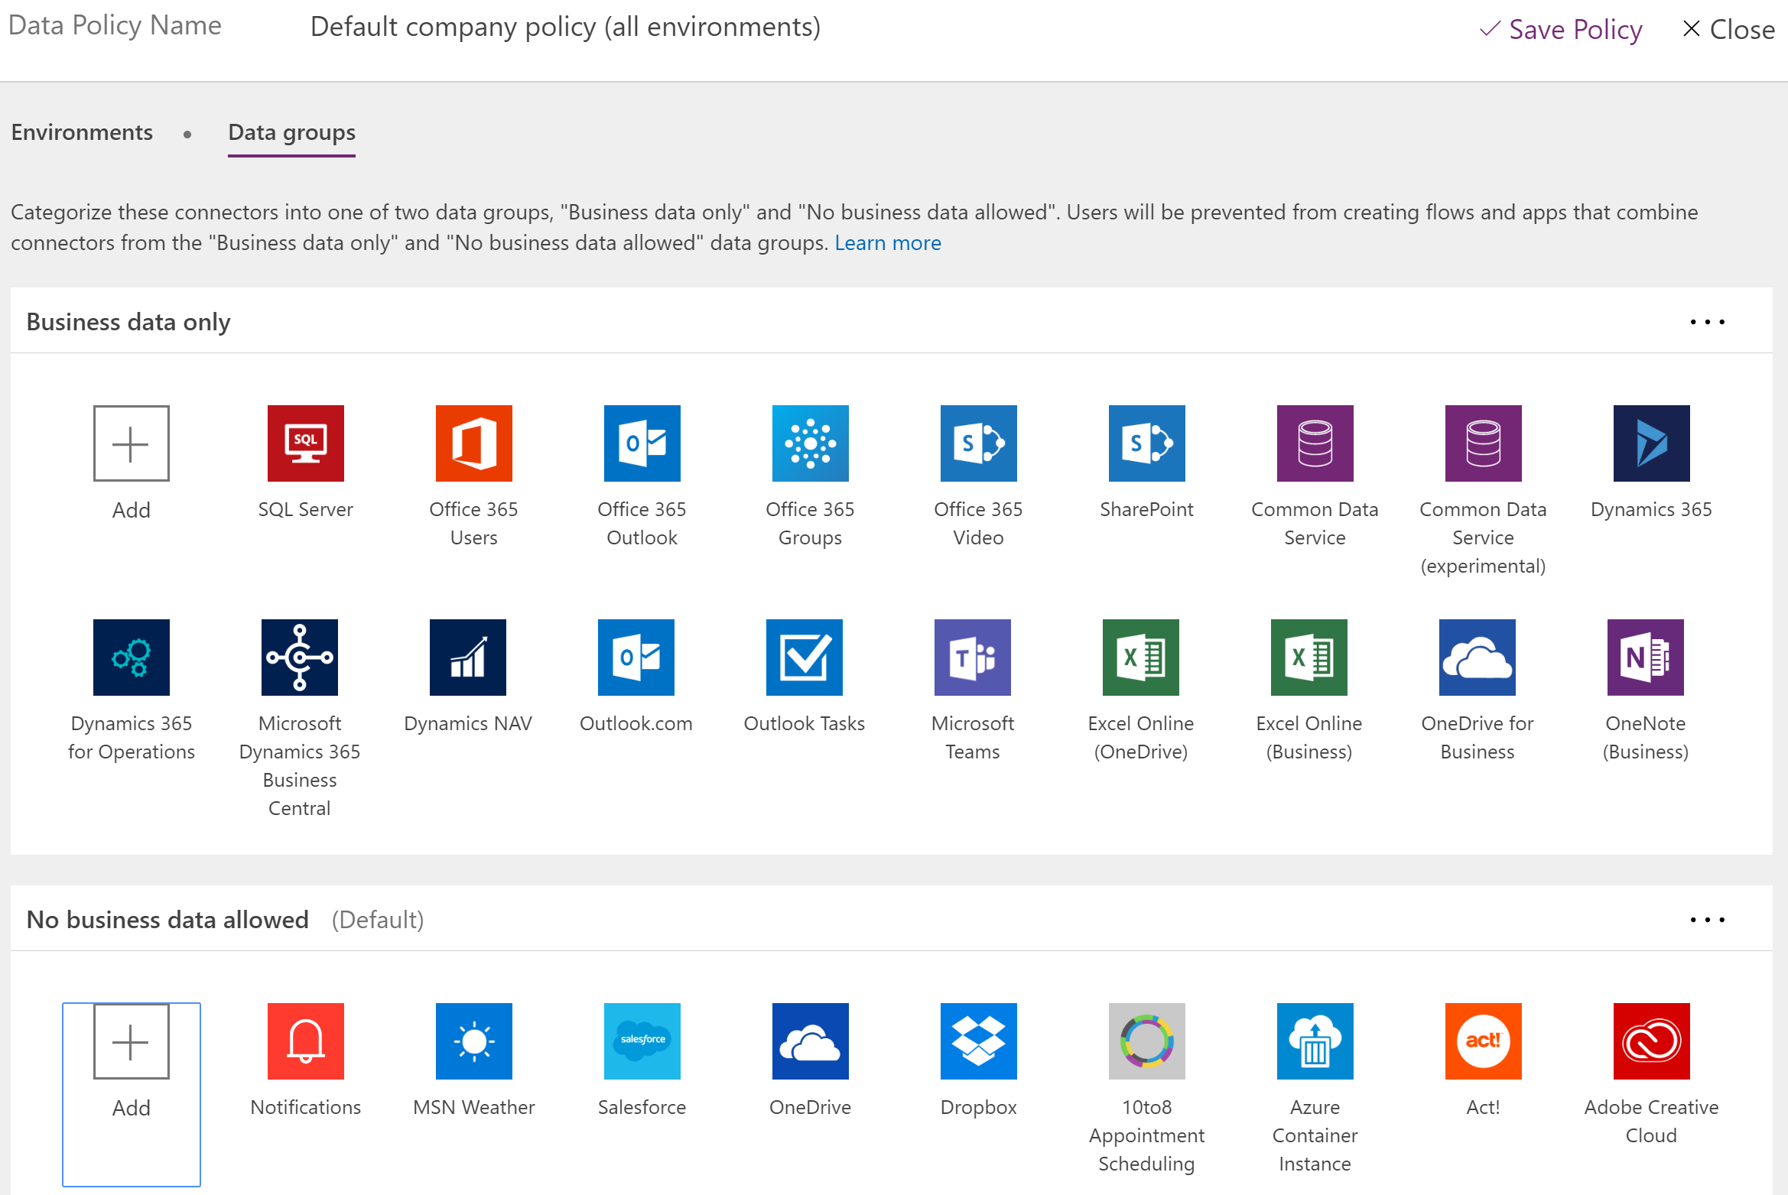
Data loss prevention key facts
Data loss prevention policies (DLP) enforce rules for which connectors can be used together
Connectors are classified as either Business Data only or No Business Data allowed
A connector in the business data only group can only be used with other connectors from that group in the same app or flow
Tenant admins can define policies that apply to all environments
Non-Microsoft connectors can fully blocked using DLP policies

Slide 11
Setup data loss prevention (DLP) policies
Create a policy spanning all environments that blocks all unsupported non-Microsoft connectors and classifies all Microsoft connectors as ‘Business Data’
#1: Block unsupported non-Microsoft connectors (e.g. Dropbox, social media)
Default
Training #1
Training #2
Dev
Dev
Test
Test
Prod
Prod
Contoso Europe
Contoso USA

Slide 12
Setup data loss prevention (DLP) policies
Create a policy spanning all environments that blocks all unsupported non-Microsoft connectors and classifies all Microsoft connectors as ‘Business Data’
Create a policy for the default environment (and other training environments) that further restricts which Microsoft connectors are classified as ‘Business Data’
#1: Block unsupported non-Microsoft connectors (e.g. Dropbox, social media)
#2: Restrict ‘business data’ connectors (e.g. only Office 365 connectors are business data)
Default
Training #1
Training #2
Dev
Dev
Test
Test
Prod
Prod
Contoso Europe
Contoso USA

Slide 13
Setup data loss prevention (DLP) policies
Create a policy spanning all environments that blocks all unsupported non-Microsoft connectors and classifies all Microsoft connectors as ‘Business Data’
Create a policy for the default environment (and other training environments) that further restricts which Microsoft connectors are classified as ‘Business Data’
Create additional policies or exclude those environment from policies #1 and #2 above that permit certain connectors to be used for specific environments: approved custom connectors
#1: Block unsupported non-Microsoft connectors (e.g. Dropbox, social media)
#2: Restrict ‘business data’ connectors (e.g. only Office 365 connectors are business data)
#3: Create exception policy for certain application environments
Default
Training #1
Training #2
Dev
Dev
Test
Test
Prod
Prod
Contoso Europe
Contoso USA

Slide 14
Monitor your tenant’s activity

Slide 15
Logs & analytics – see what’s happening
1. PowerApps and Flow logs available at https://protection.office.com
The audit records are stored in Office 365 Security and Compliance center.
Must have an Office 365 E3 or greater license
Must enabled at the organization level
Office provides an API to query this data, which is currently used by many SIEM vendors to use the Activity Logging data for reporting
Microsoft Flow | PowerApps
Created flow Edited flow Deleted flow Edited permissions Deleted permissions Started a paid trial Renewed a paid trial | Created app Edited/save app (draft) Published app Deleted app Restored an app from app version Launched app Marking app as featured Marking app as hero Edited app permissions Deleted app permissions

Slide 16
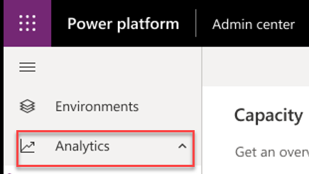
Logs & analytics – see what’s happening
1. PowerApps and Flow logs available at https://protection.office.com
2. Admin analytics available at https://aka.ms/ppac
Tenant and environment level analytics
Available from Power Platform admin center
Access is available for environment admins
Data is stored for 28 days
Data is refreshed daily
Capacity Management
Common Data Service
Microsoft Flow
PowerApps

Slide 17
Alert & act on that activity

Slide 18


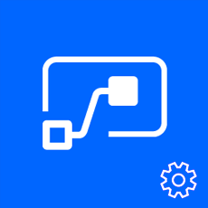

Leverage management connectors & PowerShell as powerful reporting tools + tools for action
The PowerShell Cmdlets give admins full visibility to all activity for PowerApps and Flow in their organization - aka.ms/powerappspowershell.
Management connectors
Full visibility: Power Platform APIs in an accessible connector interface, provide admin access to resources
Customization : Pull the metadata you need to build the custom reports you want
Flexibility: Build the policies you need to implement administration + governance requirements
Power Platform for Admins
PowerApps for Admins
Flow Management
PowerApps for App Makers

Slide 19
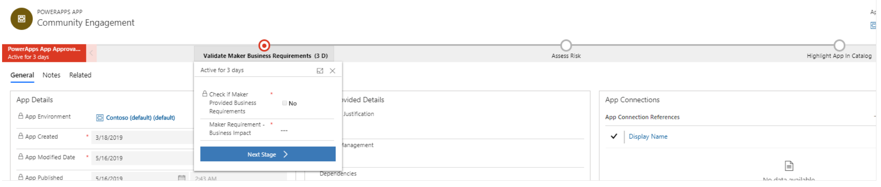
Establish and automate your audit process
Create your own workflows using the management connectors that permit or restrict behavior based on your organization’s policies (e.g. create an attestation process for assets in the default env)
CoE starter kit comes with its own audit workflow template:
Canvas app, flow creation | aka.ms/restrictappcreators
Specific connector usage | aka.ms/restrictflowconnector aka.ms/restrictappconnector
Newly added connectors | aka.ms/newconnectornotification

Slide 20
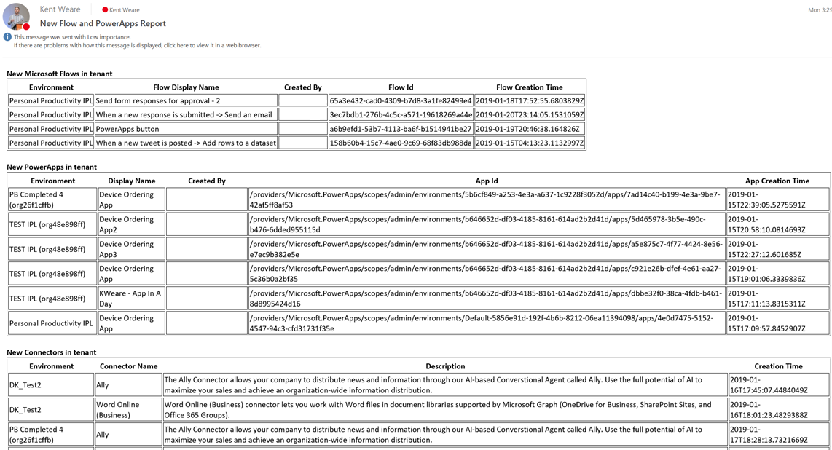
Welcome new makers and identify champions
Welcome new makers
Detect when new flow has been created
Check to see if they are part of makers AAD Group
If new, send welcome email with company and public resources
Invite them to Internal Yammer Club
https://aka.ms/powerwelcomeemail
Identify champions
New Flow, PowerApps and Connectors Digest
Sent Daily
Oversight
Empower new users
https://aka.ms/newmakerdigest

Slide 21
Best Practices

Slide 22
Best Practices for Flow Authoring
Rename action cards
Add comments
Don't touch production, work on a copy!
Prototype with button triggers
Iterate – build your flow one piece at a time
Use variables/compose to simplify checks & conditions
Keep it simple

Slide 23


Flow duration :
30 days
Controller pattern
Flow Approval
duration : 30 days
250 actions/flow
Create nested flows or raise a ticket
Loops
Max 5,000 iterations in Do until –> Create embedded loops
Max 5,000 iterations in For each (100,000 in Plan 1)
No custom task forms
Custom approval actions
No guest access
In the roadmap for Flow & PowerApps
No State Machine
State machine pattern or Controller pattern
ALM/devops weak
I could tell you, but then I would have to kill you…
Cannot resume flow
In the roadmap

Slide 24
Customer Stories
Questions

Slide 26












Jenkins NS
Modern Workplace Solution Architect | Consultant
Microsoft Teams, Power Platform and SPFx Specialist
International Speaker | Blogger | Trainer
SPS Bangalore Organizer
aOS Ambassador
jenkinsns@gmail.com
in/jenkinsns
@jenkinsns
http://www.jenkinsblogs.com
jenkinsns
https://www.facebook.com/spfxinfo/
https://www.facebook.com/msteamsinfo

